Slide 1
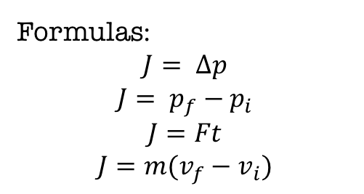
Impulse
Example 2:
A worker applies 107 Newton force is to a crate to move it across a smooth floor (negligible friction).The force is applied for 3 seconds. What is the Impulse on the crate?
F = _______
t = _______
Example 2 (Continued):
If the 24 kilogram crate was initially at rest, How fast was it moving after the force was applied?
J = _______ (from #2)
m = _______
v_{i} = _______
Impulse is the change in momentum.
Variable: J
Unit: Ns = Kg m/s
Formulas:
$$J= ∆p$$
$$J= p_{f}−p_{i}$$
$$J=Ft$$
$$J=m(v_{f}−v_{i})$$
Example 1:
A car changes momentum from 50Ns to 75 Ns. What is the Impulse on the car?
p_{i} = _______
p_{f} = _______
Example 3:
A 0.003 kg ball is moving at 90 m/s when a batter hits it. After the impact, the ball’s new velocity is – 175 m/s. What is the Impulse on the ball?
v_{i} = _______
v_{f} = _______
m = _______

Slide 2
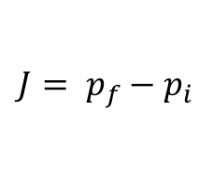
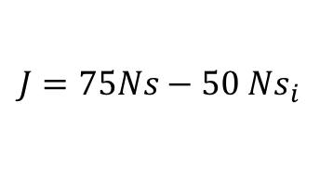
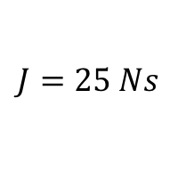
Impulse
Example 2:
A worker applies 107 Newton force is to a crate to move it across a smooth floor (negligible friction).The force is applied for 3 seconds. What is the Impulse on the crate?
F = _______
t = _______
Example 2 (Continued):
If the 24 kilogram crate was initially at rest, How fast was it moving after the force was applied?
J = _______ (from #2)
m = _______
v_{i} = _______
Impulse is the change in momentum.
Variable: J
Unit: Ns = Kg m/s
Formulas:
$$J= ∆p$$
$$J= p_{f}−p_{i}$$
$$J=Ft$$
$$J=m(v_{f}−v_{i})$$
Example 1:
A car changes momentum from 50Ns to 75 Ns. What is the Impulse on the car?
p_{i} = _______
p_{f} = _______
Example 3:
A 0.003 kg ball is moving at 90 m/s when a batter hits it. After the impact, the ball’s new velocity is – 175 m/s. What is the Impulse on the ball?
v_{i} = _______
v_{f} = _______
m = _______
50 Ns
$$J= p_{f}−p_{i}$$
75 Ns
$$J=75Ns−{50 Ns}_{i}$$
$$J=25 Ns$$
The impulse on the car is 25 Ns.

Slide 3


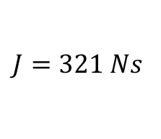
Impulse
Example 2:
A worker applies 107 Newton force is to a crate to move it across a smooth floor (negligible friction).The force is applied for 3 seconds. What is the Impulse on the crate?
F = _______
t = _______
Example 2 (Continued):
If the 24 kilogram crate was initially at rest, How fast was it moving after the force was applied?
J = _______ (from #2)
m = _______
v_{i} = _______
Impulse is the change in momentum.
Variable: J
Unit: Ns = Kg m/s
107 N
Formulas:
$$J= ∆p$$
$$J= p_{f}−p_{i}$$
$$J=Ft$$
$$J=m(v_{f}−v_{i})$$
3s
$$J=Ft$$
$$J=(107N)(3s)$$
$$J=321 Ns$$
Example 1:
A car changes momentum from 50Ns to 75 Ns. What is the Impulse on the car?
p_{i} = _______
p_{f} = _______
Example 3:
A 0.003 kg ball is moving at 90 m/s when a batter hits it. After the impact, the ball’s new velocity is – 175 m/s. What is the Impulse on the ball?
v_{i} = _______
v_{f} = _______
m = _______

Slide 4
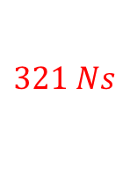
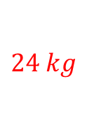


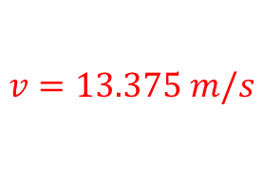

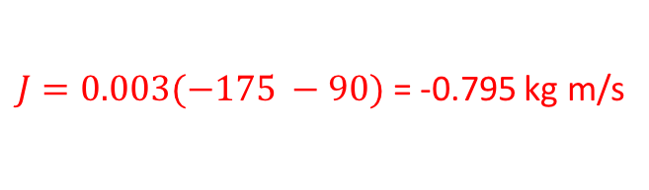

$$J=m(v_{f}−v_{i})$$
Example 2:
A worker applies 107 Newton force is to a crate to move it across a smooth floor (negligible friction).The force is applied for 3 seconds. What is the Impulse on the crate?
F = _______
t = _______
Example 2 (Continued):
If the 24 kilogram crate was initially at rest, How fast was it moving after the force was applied?
J = _______ (from #2)
m = _______
v_{i} = _______
Impulse is the change in momentum.
Variable: J
Unit: Ns = Kg m/s
$$321 Ns$$
$$24 kg$$
Formulas:
$$J= ∆p$$
$$J= p_{f}−p_{i}$$
$$J=Ft$$
$$J=m(v_{f}−v_{i})$$
$$0$$
$$321=24(v_{f}−0)$$
$$v=13.375 m/s$$
Example 1:
A car changes momentum from 50Ns to 75 Ns. What is the Impulse on the car?
p_{i} = _______
p_{f} = _______
Example 3:
A 0.003 kg ball is moving at 90 m/s when a batter hits it. After the impact, the ball’s new velocity is – 175 m/s. What is the Impulse on the ball?
v_{i} = 90 m/s
v_{f} = – 175 m/s.
m = 0.003 kg
$$J=m(v_{f}−v_{i})$$
$J=0.003(−175 −90)$ = -0.795 kg m/s

Slide 5
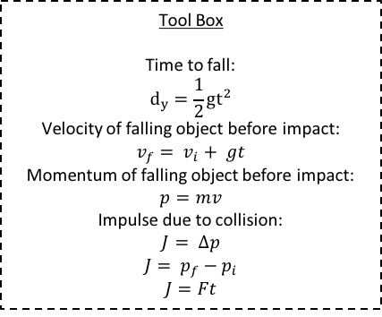

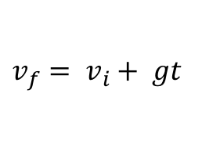

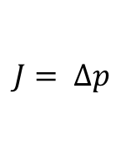

Egg Landing Pad Analysis
Drop Height when the egg breaks:
d_{y} = _______
Determine the minimum time it takes to bring the egg to rest without breaking.
F _{min} = 63.63 N (Minimum force to break an egg)
$$d_{y}=\frac{1}{2}gt^{2}$$
1. Find the time in the air.
2. Find the velocity when it hits the ground.
$$v_{f}= v_{i}+ gt$$
$$p=mv$$
3. Find the egg’s momentum when it reaches the ground.
$$J= ∆p$$
4. Find the impulse on the egg.
$$J=Ft$$
5. Find the time to stop the egg.
Tool Box
Time to fall:
$$d_{y}=\frac{1}{2}gt^{2}$$
Velocity of falling object before impact:
$$v_{f}= v_{i}+ gt$$
Momentum of falling object before impact:
$$p=mv$$
Impulse due to collision:
$$J= ∆p$$
$$J= p_{f}−p_{i}$$
$$J=Ft$$

Slide 6
Paper tube
Paper hinges
Paper coil
Paper funnel
Paper shreds
Paper spring

Slide 7
For next time:
4th Hour
Come to class prepared with ideas for your egg landing pad. Your group will have only one day to build your design.
1
3
Ackley, Alyssa
Colding, Aireonna
Jones, Gavin
Wesner, Alexandra
5
Elling, Brennan
Tahirovic, Amina
Campbell, Hannah
Peraza, Kaylee
Hamilton, Zachary
Pennington, Luke
4
2

Slide 8
For next time:
5th Hour
. Your group will has only one day to build your design.
Allende-Flores, Leonardo
Arellano, Roberto
Barclay, Brenden
Brinsa, Blake
3
Green, Joshua
Greer, Jeremy
Humphrey, Andrew
Murray, Hunter
Delgado, Aaron
Morgan, Daniel
Streit, Joseph
Ahmed, Salma
Birlingmair, Shannon
Callahan, Hayleigh
Maricic, Stefani
5
7
1
Duong, Eric
Fredde, Tarryn
Hawkins, Ashton
Mapes, Megan
Chavez-Rincon, Michelle
Mohamud, Sumaiya
Stewart, Aislynn
Stone, Eden
Davis, Amyah
ODell, Elizabeth
Pedrino, Louella
Swanger, Laine
Lupercio, Juliana
Mathis, Maryanne
Nguyen, Dante
Torres, Edward
2
6
8
4

Slide 9
For next time:
6th Hour
. Your group will has only one day to build your design.
Walker, Abigail
Welch, Ethan
Willhoit, Howard
1
Brown Jr, Daniel
Hansen, Jacob
Hernandez, Javier
3
Bingham, Danielle
Herz, Kyle
Nguyen, Bill
4
Kerns, Alex
Rodriguez, Isabella
Sanders, Jakob
2

Slide 10

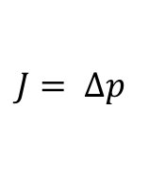

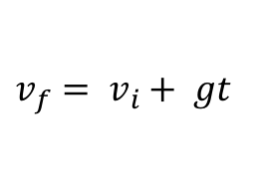



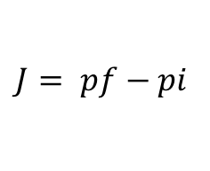
Skull Fractures
In the Journal of Neurosurgery: Pediatrics, a researcher wrote that 2,300 newtons of force would be needed to crush a human skull.
A 65 kg rock that dropped from a cliff. strikes a person on the head causing a skull fracture. If the rock comes to a stop over 0.034 seconds, how high was the cliff?
(Complete the Egg Drop Calculations Backward)
$$J=Ft$$
1. Find the impulse on the person's skull.
$$J=_____Ns$$
$$J= pf−pi$$
$$J= ∆p$$
or
2. Find the rock’s momentum right before it hits the person’s head.
$$J=_____Ns$$
p_{i} = _________
p_{f} = 0
3. Find the velocity when the rock hits the person’s head.
$$p=mv$$
p_{i} = _________
v_{f}= ___________
m = ______kg
4. Find the time in the air.
$$v_{f}= v_{i}+ gt$$
v_{f}= ___________
t= __________
v_{i} = 0
g= 9.8 m/s/s
$$d_{y}=\frac{1}{2}gt^{2}$$
5. Find height that the rock was dropped from.
t= __________
d_{y}= ________
g= 9.8 m/s/s

